Slide 1
Object Oriented Programming
Semester II Lecturer: Sir Talha Ghouri

Slide 2
Callbacks
What is a Callback?
A callback is a function or method that is passed as an argument to another function or object and is executed (called back) at a later time when a specific event or condition occurs.
def greet():
print("Hello, World!")
def execute_callback(callback):
callback()
execute_callback(greet)
Callbacks are commonly used in:
Event-driven programming
Graphical User Interfaces (GUI)
Asynchronous programming
Frameworks and libraries
Object-Oriented Programming (OOP)
OUTPUT
Hello, World!
Here, greet() is passed as a callback to execute_callback().

Slide 3
Callback in OOP
A method of an object can also be used as a callback.
class Student:
def show_message(self):
print("Assignment submitted successfully!")
class Assignment:
def submit(self, callback):
print("Processing submission...")
callback()
student = Student()
assignment = Assignment()
assignment.submit(student.show_message)
OUTPUT
Processing submission...
Assignment submitted successfully!

Slide 4
Callback with Parameters
class Calculator:
def calculate(self, a, b, callback):
result = a + b
callback(result)
def display(result):
print("Result =", result)
calc = Calculator()
calc.calculate(10, 20, display)
OUTPUT
Result = 30

Slide 5
GUI (Graphical User Interface) Concepts
What is a GUI?
A Graphical User Interface (GUI) allows users to interact with a program through graphical elements such as windows, buttons, menus, icons, and text boxes instead of typing commands.
Examples of GUI applications:
Web browsers
Calculator applications
Microsoft Word
Media players
In Python, GUI applications are commonly developed using libraries such as:
Tkinter
PyQt
PySide
Kivy

Slide 6
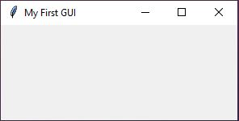
Main Components of a GUI
1. Window
A window is the main container that holds all GUI elements.
import tkinter as tk
window = tk.Tk()
window.title("My First GUI")
window.mainloop()

Slide 7
2. Widgets
Widgets are graphical controls placed inside a window.
Common widgets include:
Widget | Purpose
Label | Display text
Button | Perform an action
Entry | Accept user input
Text | Multi-line text input
Checkbutton | Checkbox
Radiobutton | Multiple-choice selection
Listbox | Display a list
Menu | Menu bar

Slide 8

3. Label Widget
Displays text or information.
import tkinter as tk
window = tk.Tk()
label = tk.Label(window, text="Welcome to GUI Programming")
label.pack()
window.mainloop()

Slide 9

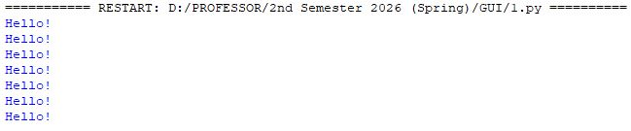
4. Button Widget
Performs an action when clicked.
import tkinter as tk
def greet():
print("Hello!")
window = tk.Tk()
button = tk.Button(window, text="Click Me", command=greet)
button.pack()
window.mainloop()

Slide 10

5. Entry Widget
Accepts user input.
import tkinter as tk
window = tk.Tk()
entry = tk.Entry(window)
entry.pack()
window.mainloop()

Slide 11
Event-Driven Programming
Event-Driven Programming is a programming paradigm in which the flow of a program is controlled by events. The program waits for events to occur and then responds by executing specific code called event handlers or callbacks.
An event can be:
A mouse click
A key press
A button click
A file opening
A timer expiring
A network message arriving
Event-driven programming is widely used in:
GUI applications
Web applications
Games
Mobile applications

Slide 12
Event-Driven Program Flow
Program Starts
│
Event Loop Starts
│
Wait for Event
│
Event Occurs
│
Event Handler Executes
│
Program Continues Waiting

Slide 13
Simple Example (Without GUI)
def greet():
print("Welcome!")
def trigger_event(callback):
print("Event Occurred")
callback()
trigger_event(greet)

Slide 14

The GUI waits for events and responds when they occur.
import tkinter as tk
def button_clicked():
print("Button was clicked")
window = tk.Tk()
button = tk.Button(
window,
text="Click",
command=button_clicked
)
button.pack()
window.mainloop()

Slide 15
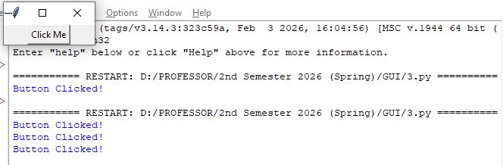
GUI Example Using Tkinter
import tkinter as tk
def button_clicked():
print("Button Clicked!")
window = tk.Tk()
button = tk.Button(
window,
text="Click Me",
command=button_clicked
)
button.pack()
window.mainloop()
User clicks the button.
The click generates an event.
Tkinter detects the event.
button_clicked() executes.
The message is displayed.

